Slide 1

X.25 Protocol And Frame Relay
Nikhil Lathiya

Slide 2
What is Protocol ….????
Protocol is nothing but a “Set Of Rules” which are used in digital communication to connect network devices and exchange of information between them .

Slide 3


Example Of Protocol …!!
This both Computers has to be followed some set of rules To Make a connection between two computers then only it can transfer the files.

Slide 4
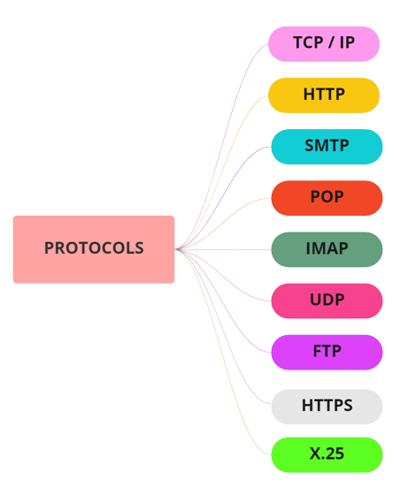

TYPES OF PROTOCOL

Slide 5
X.25 PROTOCOL
X.25 is a Packet - Switching Wide Area Network developed by ITU (International Telecommunication Union)
X.25 is a very popular protocol
It allow the remote devices to communicate with each other across High speed data links without the expense of individual leased line.
X.25 is a Connection - Oriented protocol
It allows multiple logical channels can be set on a Single Physical line
X.25 use the Store and Forward method for communication
X.25 is a suits of the lower three layers of the OSI reference model for networking

Slide 6
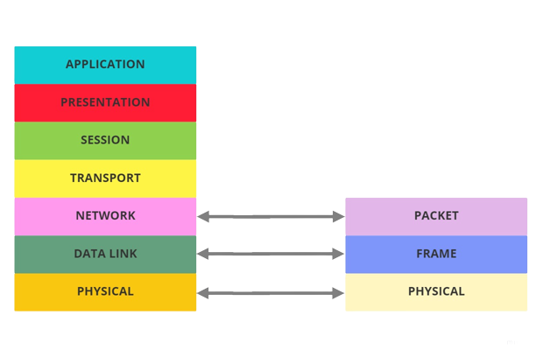
X.25 LAYER MAPPING WITH OSI MODEL
(PLP)
LAPB
X.21
OSI
X.25

Slide 7
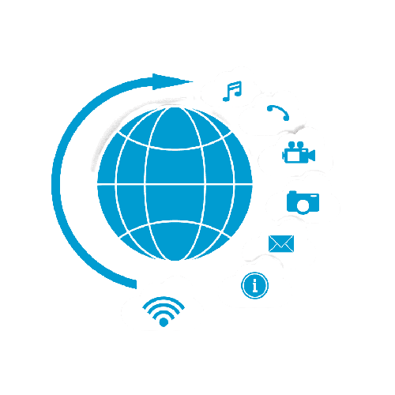
FRAME RELAY
Frame relay is a protocol that defines how frames are routed through a fast-packet network based on the address field in the frame.

Slide 8
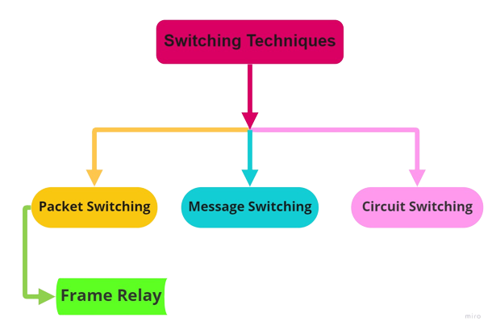
TYPES OF SWITCHING TECHNIQUES

Slide 9
Frame Relay Networks
Frame relay is a protocol that defines how frames are routed through a Fast – Packet Network
Frame relay takes advantage of the reliability of data communications networks to minimize the error checking done by the Network Nodes
This provides a packet-switching protocol similar to, but much faster than, X.25. The high speed that can be obtained through frame-relay networks makes it well suited for wide area network (WAN) connectivity.
Frame Relay is commonly used to connect two or more LAN bridges over large distances.

Slide 10
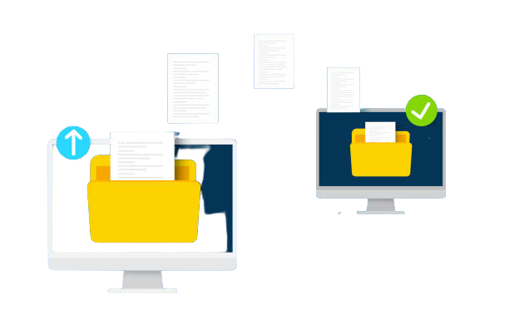

Thank You…!!!
Nikhil Lathiya

